Slide 1
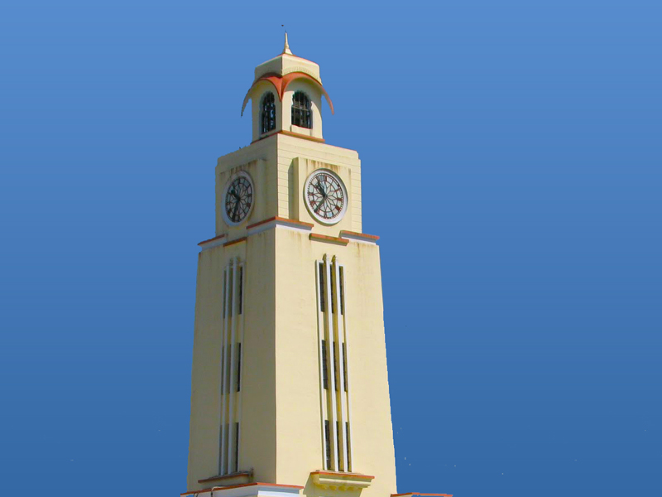
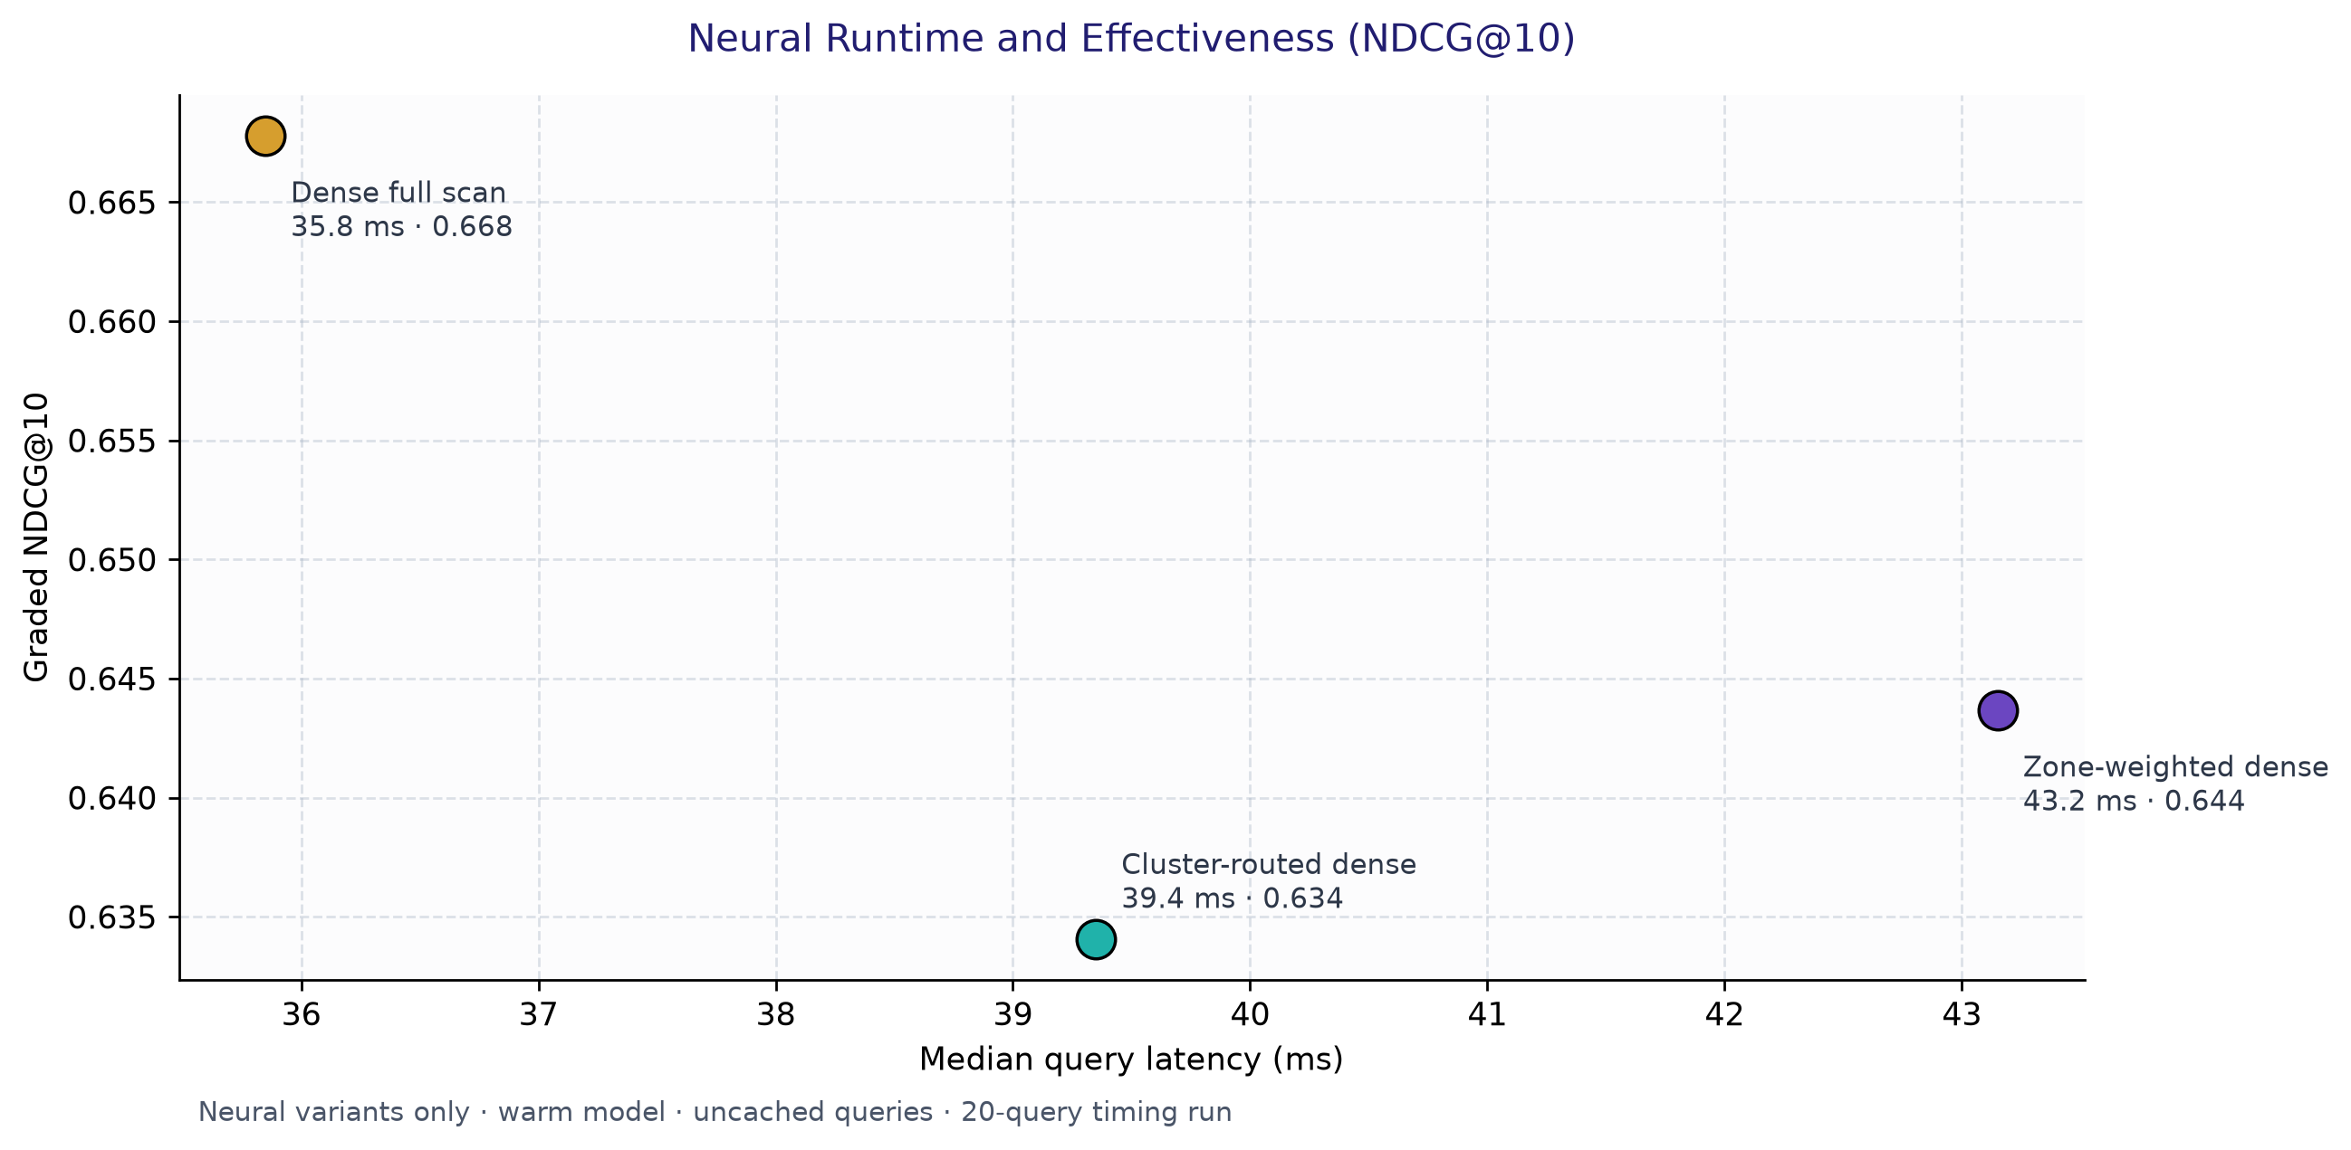

BM25 vs. Neural Retrieval
on Technical Documents
GitHub Repository : https://github.com/vishrutbhushan/ir-benchmark.git
Vishrut Bhushan 2025H1120143P
Bhagavath M S 2025H1120167P
Ajay B 2025H1120142P
Jalluri Mahesh Kumar 2025H1120061P

Slide 2
Why technical retrieval is different
Technical-document challenges
Questions examined
Exact syntax and identifiers
CLI flags, API endpoints, error signatures and version strings can be damaged by aggressive stemming.
Hierarchical content
Titles, headings, code blocks and prose carry different amounts and types of relevance signal.
Vocabulary mismatch
A symptom such as “cannot connect to database” may refer to connection pooling or TCP keepalive.
Search cost
Dense retrieval compares a query with many passage vectors; full-corpus scoring grows with corpus size.
1. Lexical vs. dense retrieval
Compare BM25/BM25F with dense neural embeddings on technical documents.
2. Candidate reduction
Measure the effect of K-Means++ cluster routing on search latency.
3. Hybrid ranking
Test whether Reciprocal Rank Fusion combines exact matching and semantic matching effectively.
4. Repeated-query cost
Measure a two-tier LRU cache for result lists and query embeddings.

Slide 3
Foundational literature and references
Lexical, Zone Scoring & Hybrid Fusion
Neural Retrieval, Clustering & Evaluation
BM25F: Multi-Field Lexical Retrieval · Robertson, Zaragoza, & Taylor (ACM CIKM 2004)
Extends BM25 to structured documents by linearly combining zone term frequencies into a composite count before applying non-linear saturation.
Parametric Zone Scoring & Indexing · Manning, Raghavan, & Schütze (Cambridge Univ. Press, 2008)
Formalizes zone-weighted scoring across document regions (titles, headings, code, and body) to capture structural document semantics.
Reciprocal Rank Fusion (RRF) · Cormack, Clarke, & Büttcher (ACM SIGIR 2009)
Introduces rank-based reciprocal discounting (1 / (k + r)) to fuse disparate retrieval systems without requiring score normalization or training.
Multi-Tier Search Engine Caching · Baeza-Yates, Gionis, Junqueira, et al. (ACM SIGIR 2007)
Proposes multi-tier caching architectures balancing instantaneous static result delivery with intermediate query representations to maximize throughput.
Dense Passage Retrieval (DPR) · Karpukhin, Oğuz, Min, et al. (EMNLP 2020)
Demonstrates dual-encoder transformer representations trained via contrastive loss to map queries and passages into a shared dense semantic space.
Passage Windowing and MaxP · Dai & Callan (SIGIR 2019)
Uses overlapping passages and MaxP aggregation to rank long documents.
k-means++: Centroid Seeding · Arthur & Vassilvitskii (ACM-SIAM SODA 2007)
Proposes D²-weighted probabilistic centroid initialization for k-means, proving an O(log k) competitive ratio and faster clustering convergence.
Graded Relevance Evaluation (NDCG) · Järvelin & Kekäläinen (ACM TOIS 2002)
Introduces Discounted Cumulative Gain (DCG/NDCG) with logarithmic position discounting to evaluate multi-grade document utility and ranking effectiveness.

Slide 4
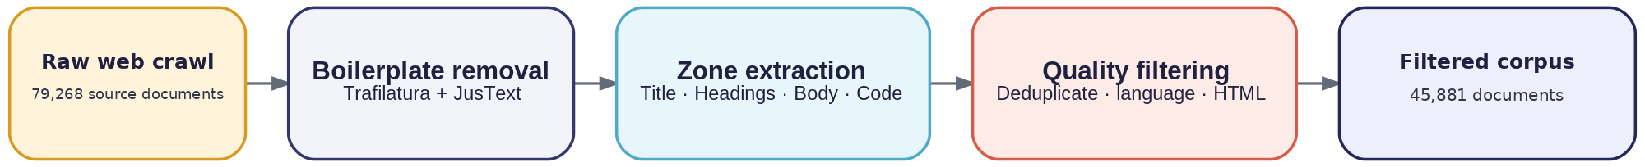
Corpus acquisition and preprocessing
Five stages from the raw crawl (https://data.commoncrawl.org/) to the searchable corpus
Categories :
Database & Search Cloud Platforms DevOps & Infrastructure AI/ML Infrastructure
OS & Networking Programming Languages Observability & Telemetry Distributed Data & Messaging
Security & Identity Application Frameworks Containers & Orchestration
42.1%
11
943,353
45,881
of raw files excluded
engineering ecosystems
unique terms
filtered documents
The cleaned corpus keeps four zones separate:
Title
Headings
Code
Body
High-density topic signal
Section and hierarchy context
Syntax and identifiers
Explanations and walkthroughs
Notes:
Mermaid flowchart source (pipeline.mmd):
flowchart LR
A["Raw web crawl<br/>18.6 GB · 79,268 files"] --> B["Boilerplate removal<br/>Trafilatura + JusText"]
B --> C["Zone extraction<br/>Title · Headings · Body · Code"]
C --> D["Quality filtering<br/>Deduplicate · Language · HTML"]
D --> E["Filtered corpus<br/>11.0 GB · 45,881 documents"]

Slide 5


Lexical retrieval with BM25F
Zone-aware indexing preserves exact technical tokens while using document structure during scoring.
Index and runtime
BM25F scoring
45,881 documents indexed across 943,353 terms.
Uncompressed JSON index file: 1.08 GB.
Runtime RAM was not measured in the saved run.
Combine zone contributions into an effective term frequency before applying saturation.
Zone weights: Title 8% · Headings 18% · Code 29% · Body 45%
Binary NDCG@10 = 0.4558 · Graded NDCG@10 = 0.4524 · MRR@10 = 0.6138
Notes:
BM25F uses zone proportions Title 8%, Headings 18%, Code 29% and Body 45%. The saved inverted-index JSON is 1.08 GB on disk. Runtime RAM was not measured.

Slide 6
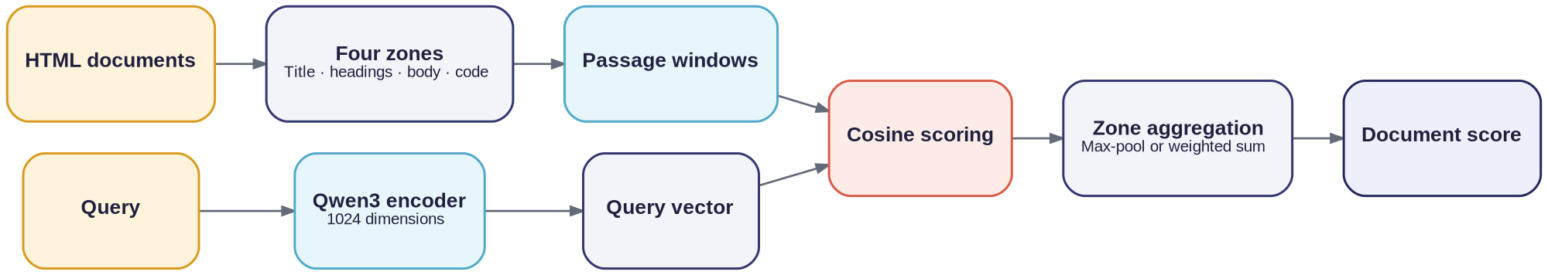
Dense neural retrieval
Dense neural embedding model (0.6B) maps queries and passage windows into normalized 1024-dimensional vectors.
Zone weights used in scoring
Title 0.08 · Headings 0.18 · Body 0.45 · Code 0.29
The same proportions are configured for BM25F and weighted neural scoring.
Headings
0.18
Title
0.08
Body
0.45
Code
0.29
0.548
0.47
35.8 ms
Binary NDCG@10 · full corpus scan
P@5 · full corpus scan
median query latency
Where dense retrieval helps
Cost of a full scan
It can match symptom wording to technical causes even when the query and document use different terms.
313,359 passage vectors scanned per full-scan query
Model weights: 1.19 GB on disk
GPU peak allocation: 2.05 GB.
Notes:
Mermaid flowchart source (dense.mmd):
flowchart LR
A["HTML documents"] --> B["Split into four zones"] --> C["Passage windows"] --> D["Cosine scoring"]
Q["Query"] --> M["Qwen3 encoder"] --> V["Query vector"] --> D
D --> P["Max-pool or weighted zone scores"] --> R["Document score"]

Slide 7
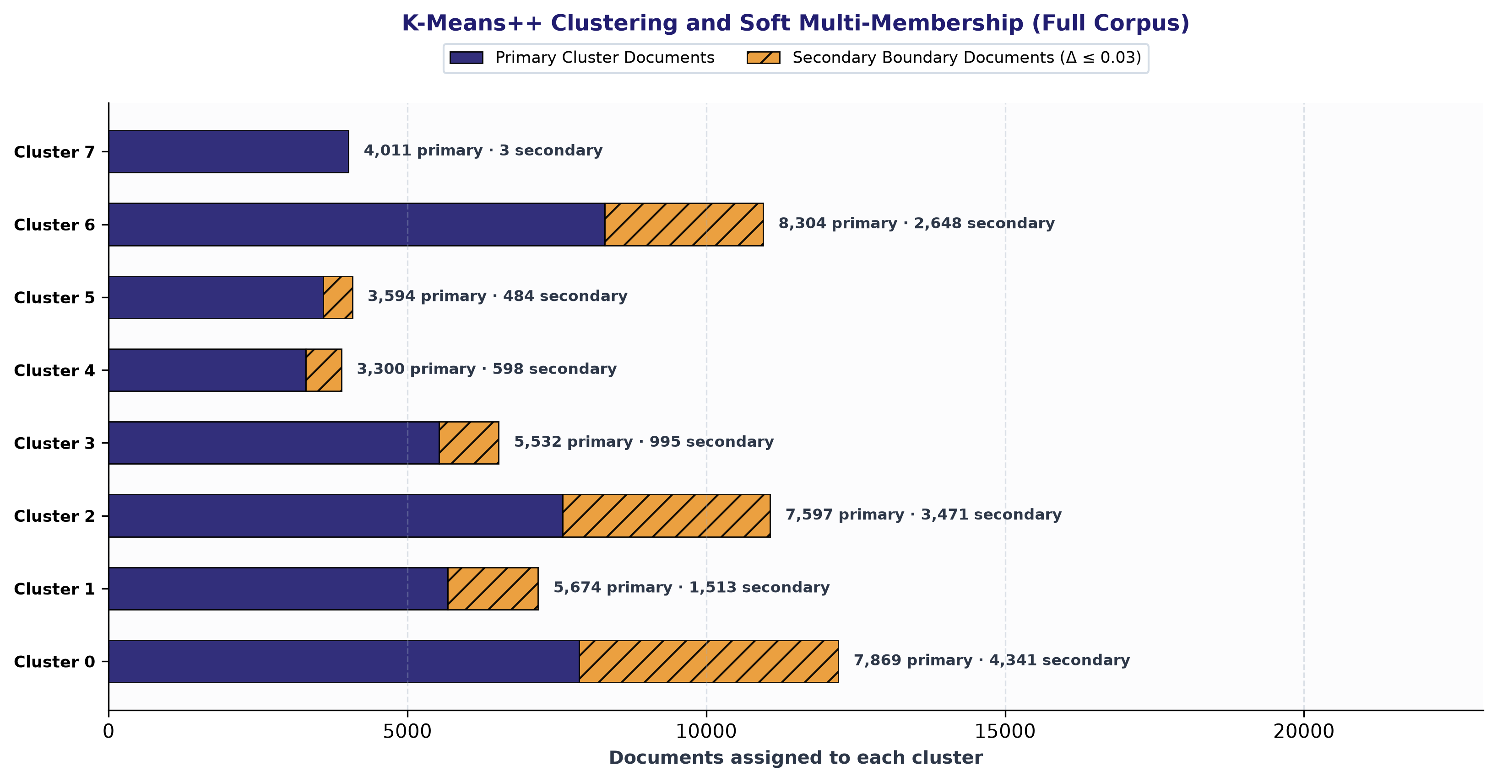
Unsupervised domain discovery
K-Means++ (k = 8) on normalized title and heading embeddings (1024 dimensions)
Interpretation
Clusters are formed without labels. Soft membership assigns 14,053 documents (30.6%) to a second cluster. Routing scans fewer passages; Binary NDCG@10 is 0.541 versus 0.548 for full dense search.

Slide 8
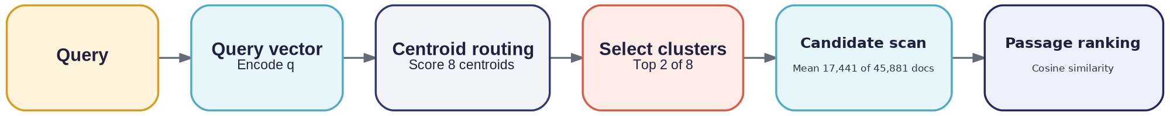
Cluster pruning
Route each query to a small subset of the corpus before computing passage similarities.
61.1%
2 / 8
39.4 ms
fewer passage vectors scanned
clusters selected per query
median routed latency
Measured routing details
The router scans a mean 122,008 passage vectors per query versus 313,359 for full scan (61.1% fewer). Median latency is 39.4 ms routed versus 35.8 ms dense; Binary NDCG@10 is 0.541 versus 0.548.
Notes:
Mermaid flowchart source (pruning.mmd):
flowchart LR
A["Query"] --> B["Encode query vector"] --> C["Score 8 centroids"] --> D["Select top 2 clusters"] --> E["Scan selected passages"] --> F["Rank candidates"]

Slide 9
Two-tier query caching
The first tier avoids retrieval; the second avoids re-encoding a repeated query.
Neural query latency
Cache behavior
Dense full scan: 35.8 ms
Zone-weighted dense: 43.2 ms
Cluster-routed dense: 39.4 ms
The result cache stores ranked documents and scores. The embedding cache stores query vectors.
Configured capacities: 16 result lists and 64 query vectors.
Notes:
Mermaid flowchart source (cache.mmd):
flowchart LR
A["Incoming query"] --> B["Normalize query + top_k"] --> C["Tier 1: result cache"]
C --> D["Tier 2: embedding cache"] --> E["Run selected retriever"] --> F["Update caches"] --> G["Return ranked results"]

Slide 10
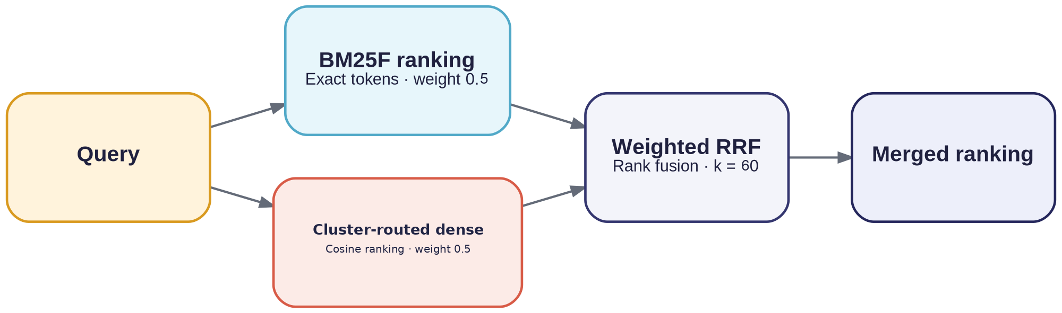
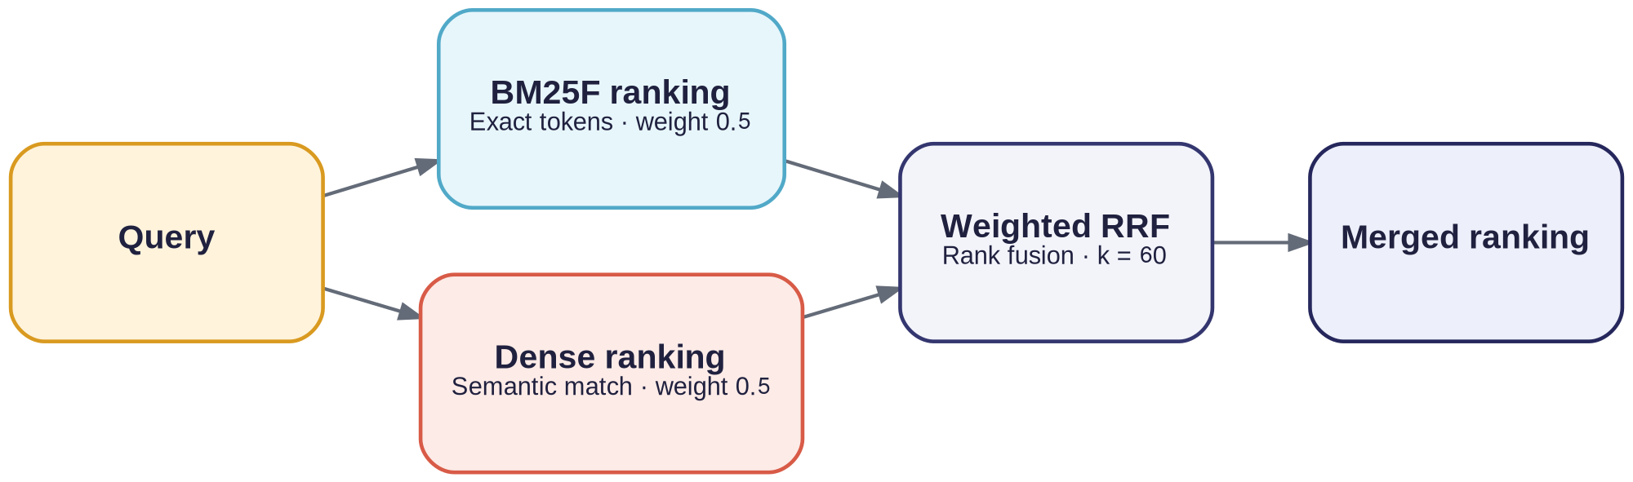
Hybrid retrieval with RRF
Reciprocal Rank Fusion combines BM25F and cluster-routed dense rankings.
Why rank fusion?
Weights and measured results
BM25 scores are unbounded, while cosine similarity is bounded between −1 and 1. Direct score mixing is sensitive to scale differences.
RRF uses rank positions instead of raw scores.
RRF Formulation:
RRF(d) = 0.5 / (60 + rank_BM25F) + 0.5 / (60 + rank_routed)
Measured Benchmark Results:
• Binary NDCG@10 = 0.5354
• Graded NDCG@10 = 0.5123
• P@5 = 0.4000 · MRR@10 = 0.7517
• Recall@10 = 0.4907
Notes:
RRF combines BM25F and cluster-routed dense rankings with equal 0.5 weights and k = 60. The equal weighting is rank-equivalent to the implementation, which adds both reciprocal-rank contributions.

Slide 11
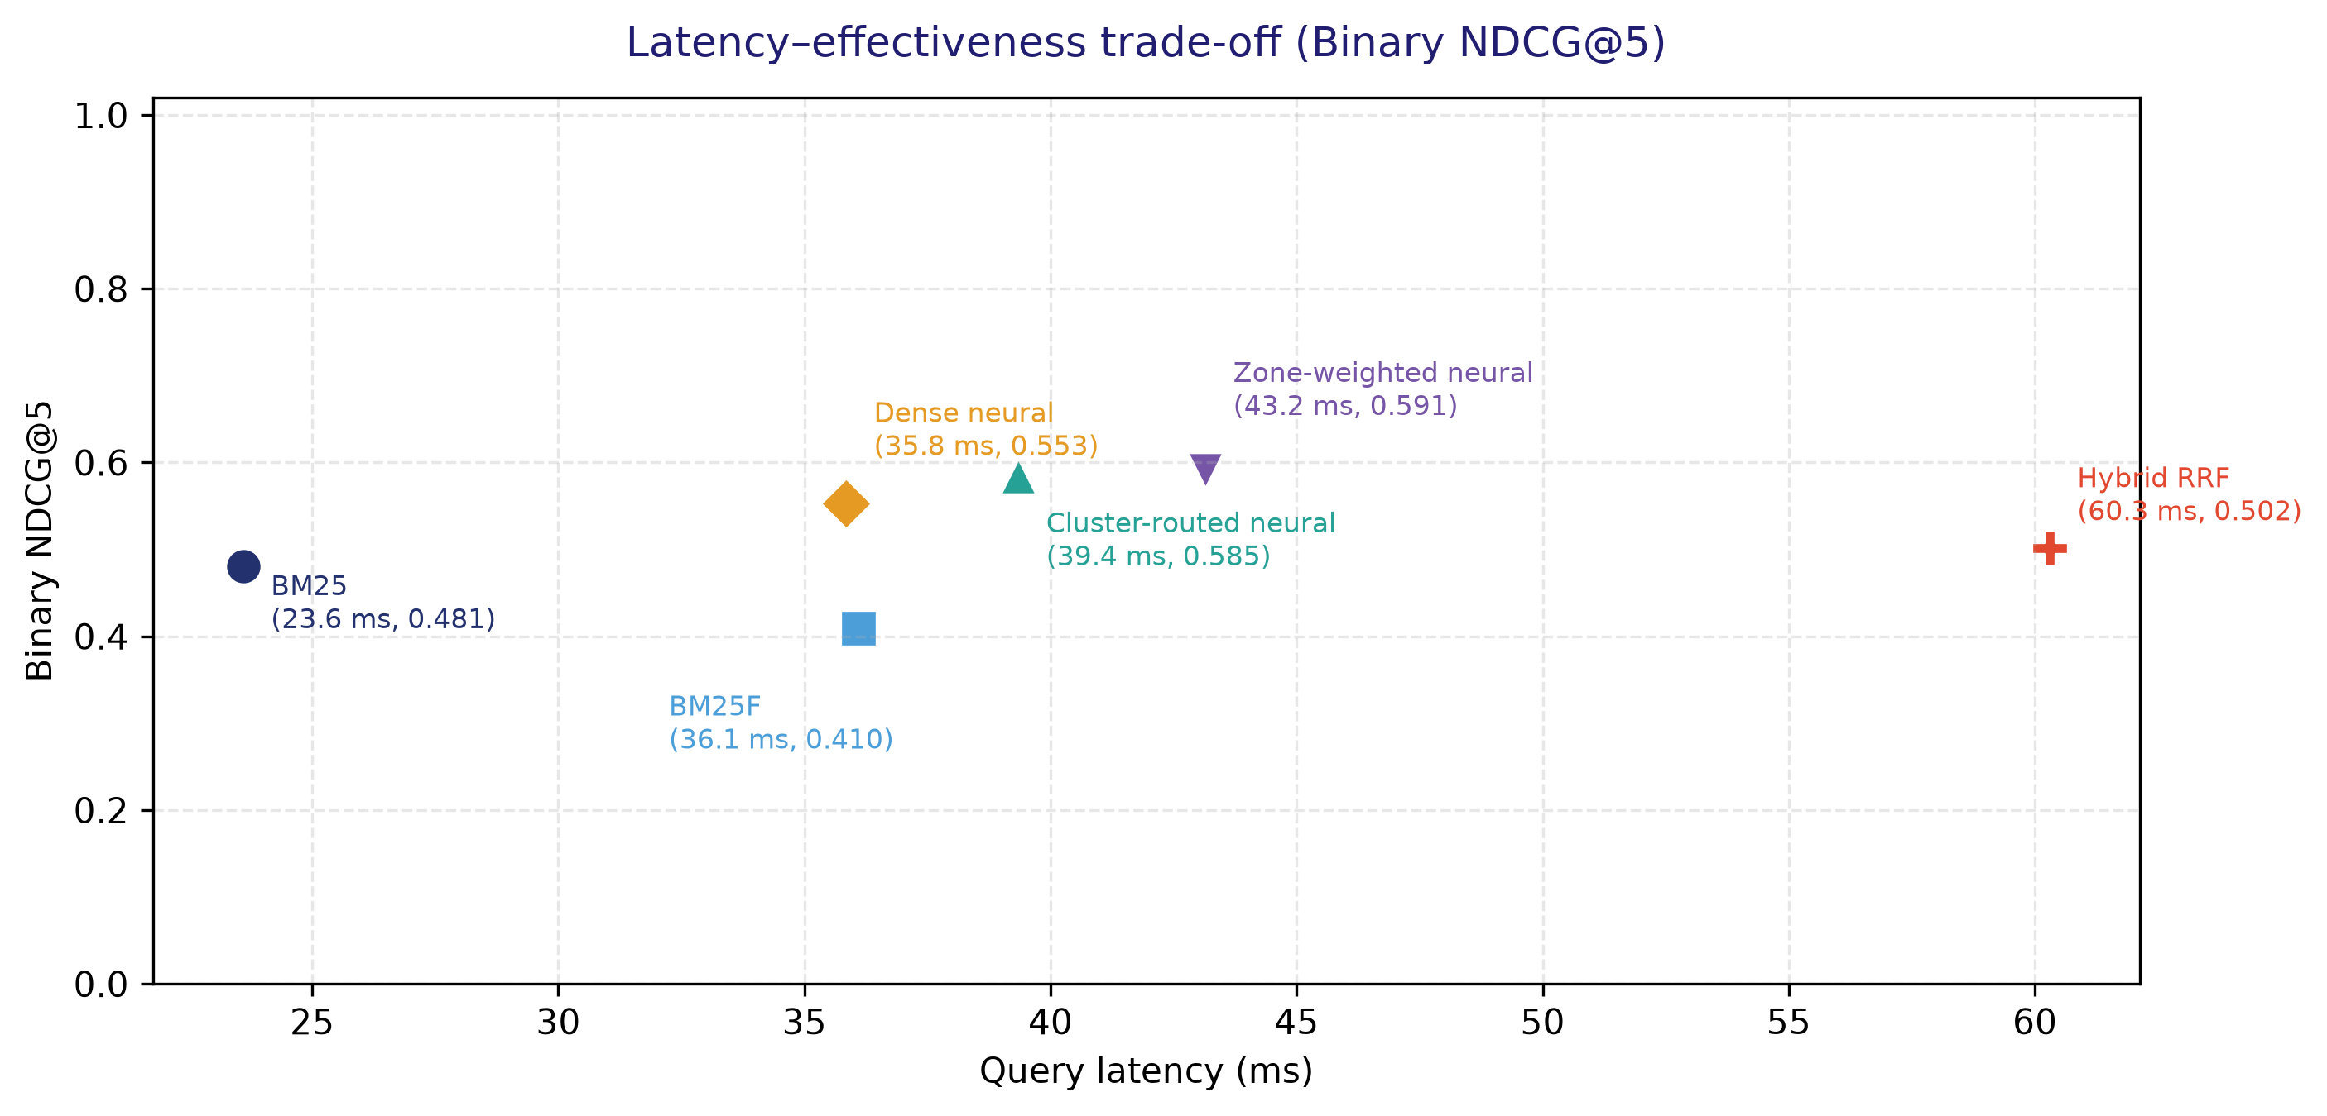
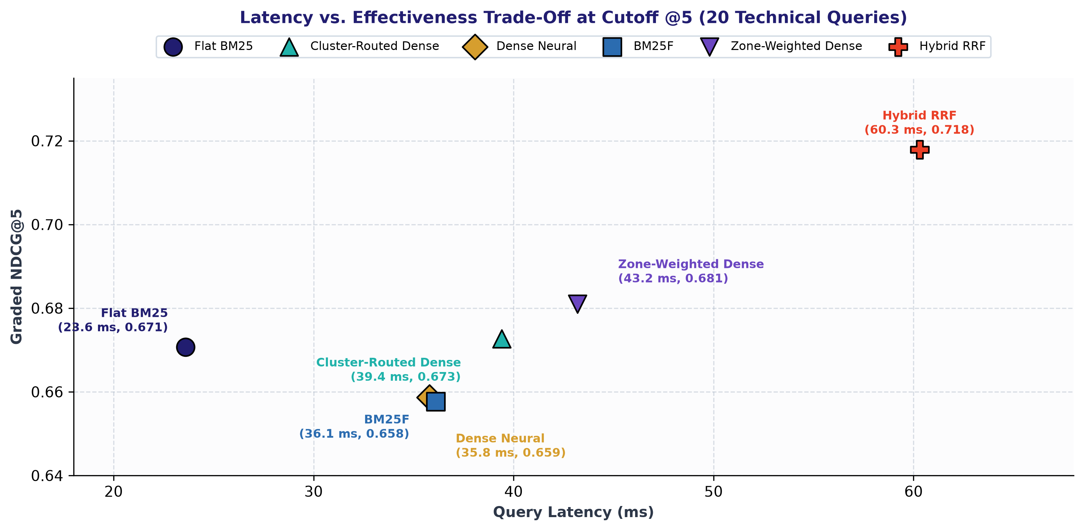
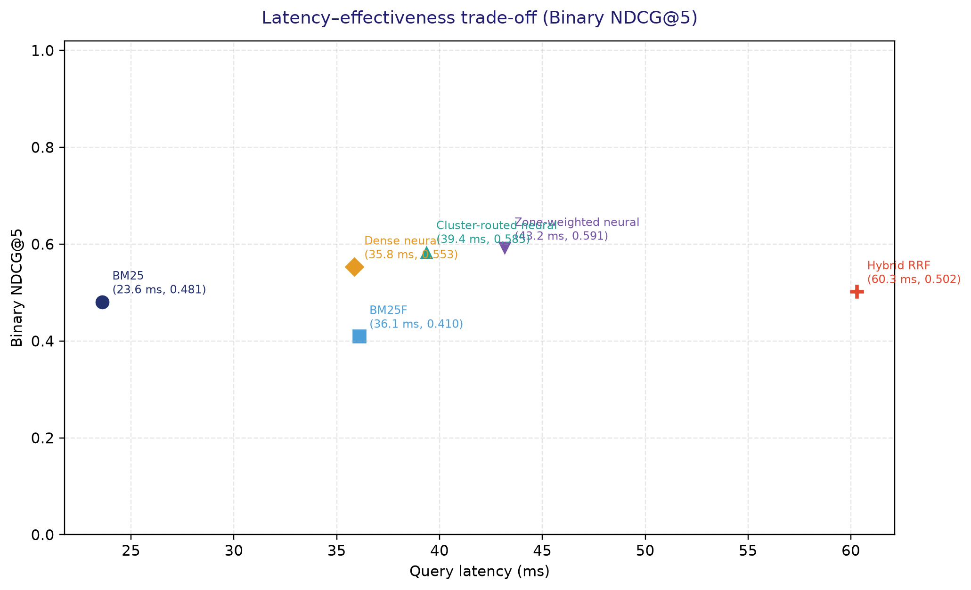
Latency–effectiveness trade-off (Cutoff @5)
Zone-weighted Dense has the highest Binary NDCG@5 (0.591).

Slide 12
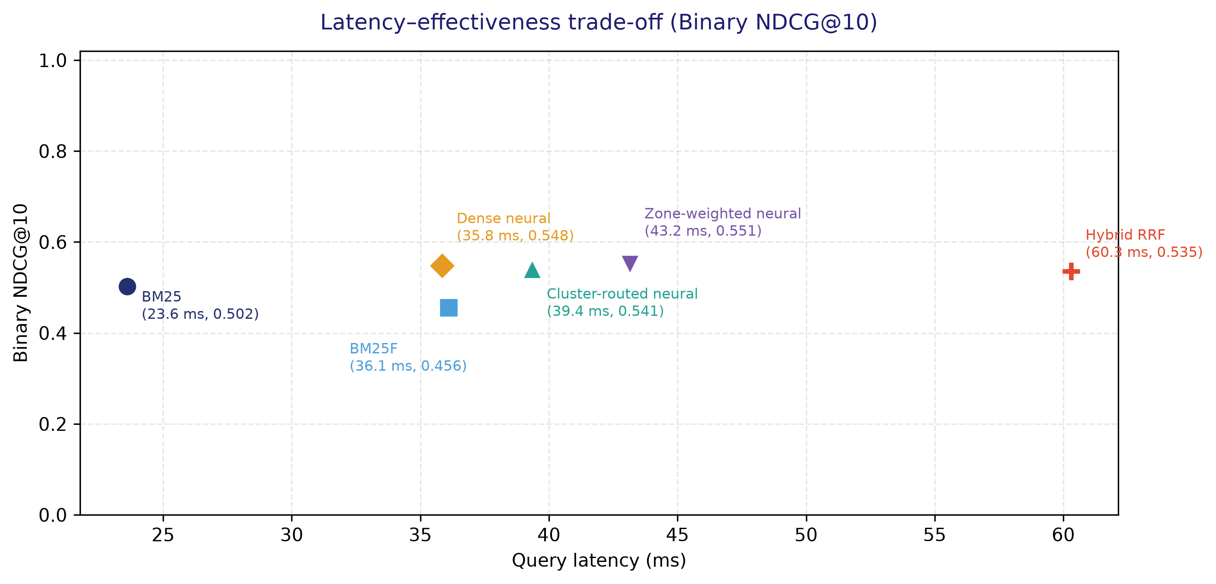
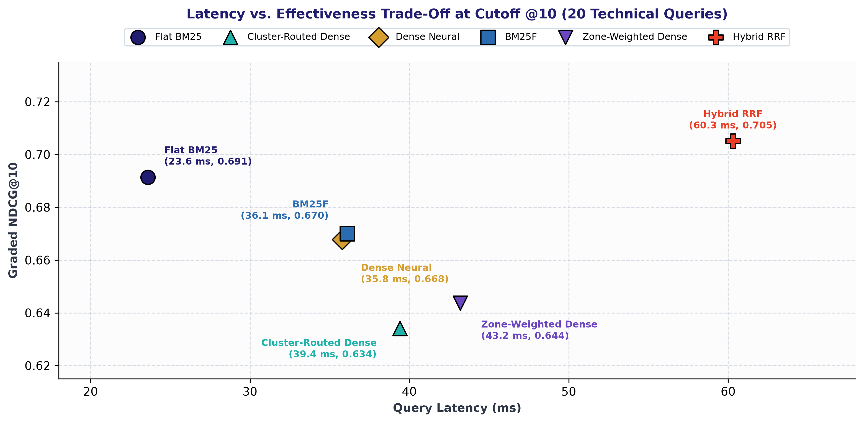
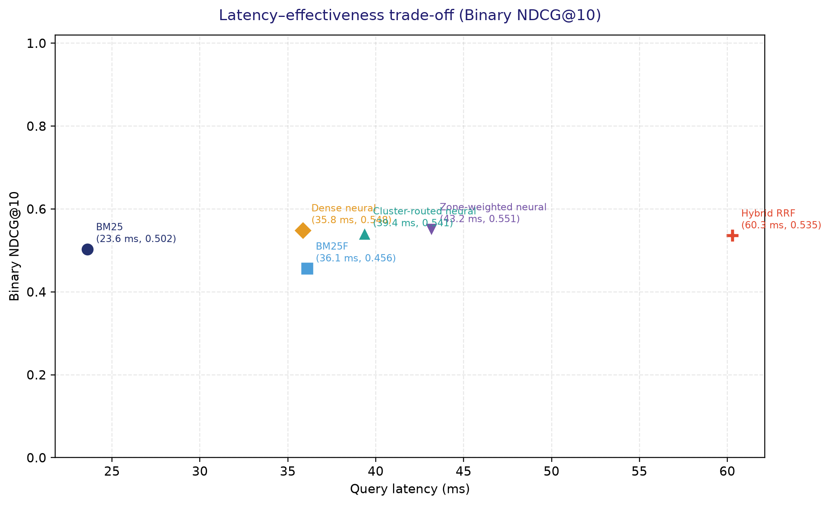
Latency–effectiveness trade-off (Cutoff @10)
Zone-weighted Dense has the highest Binary NDCG@10 (0.551).

Slide 13
Evaluation methodology
A pooled relevance set was judged by two language models before calculating retrieval metrics.
Judges and agreement
Consensus labels and metrics
2 × 2 Inter-Annotator Matrix (N = 482 Pairs)
Grade 2 · both relevant: 86
Grade 1 · one relevant: 55
Grade 0 · neither relevant: 341
Primary: Binary NDCG@5/@10. Secondary: Graded NDCG@10, P@k, Recall, MAP and MRR.
Judge Alignment | Nemotron = 1 | Nemotron = 0 | Total
Gemma = 1 (Rel) | 86 | 33 | 119
Gemma = 0 (Not Rel) | 22 | 341 | 363
Nemotron Total | 108 | 374 | 482
Observed Agreement: 88.6% (427 / 482)_x000B_Cohen's κ = 0.683
Consensus: Grade 2 (86) · Grade 1 (55) · Grade 0 (341)
Notes:
Twenty evaluation queries were run through six retrieval methods. The top-10 result pool contains 482 unique query-document pairs from the six methods; each pair has two judge labels and a consensus grade. Grade 2: 86, Grade 1: 55, Grade 0: 341. Binary NDCG is primary; graded NDCG is secondary.

Slide 14
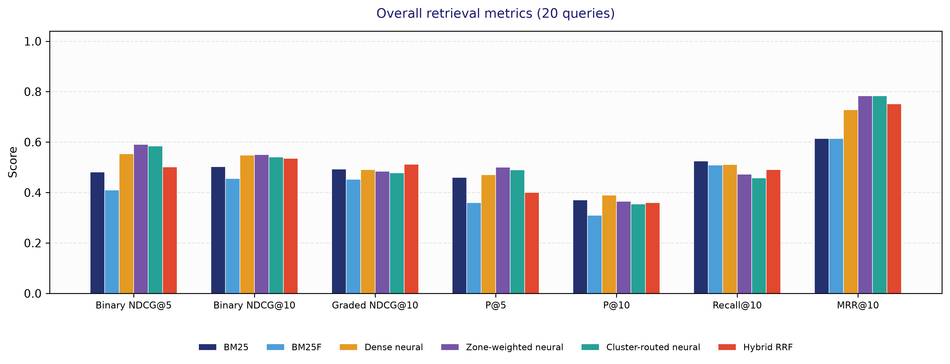
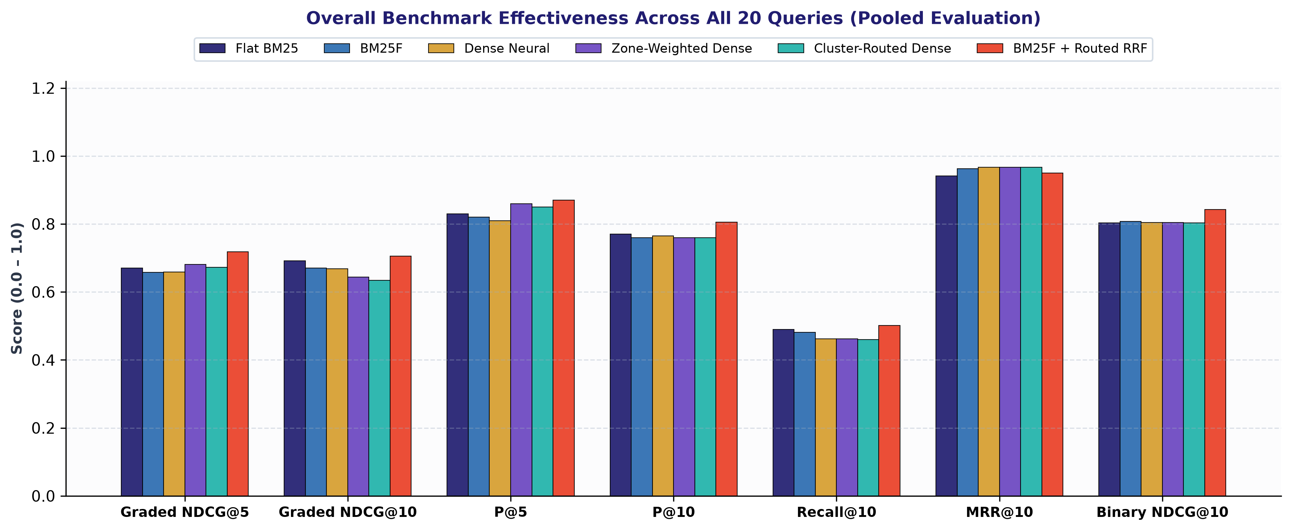
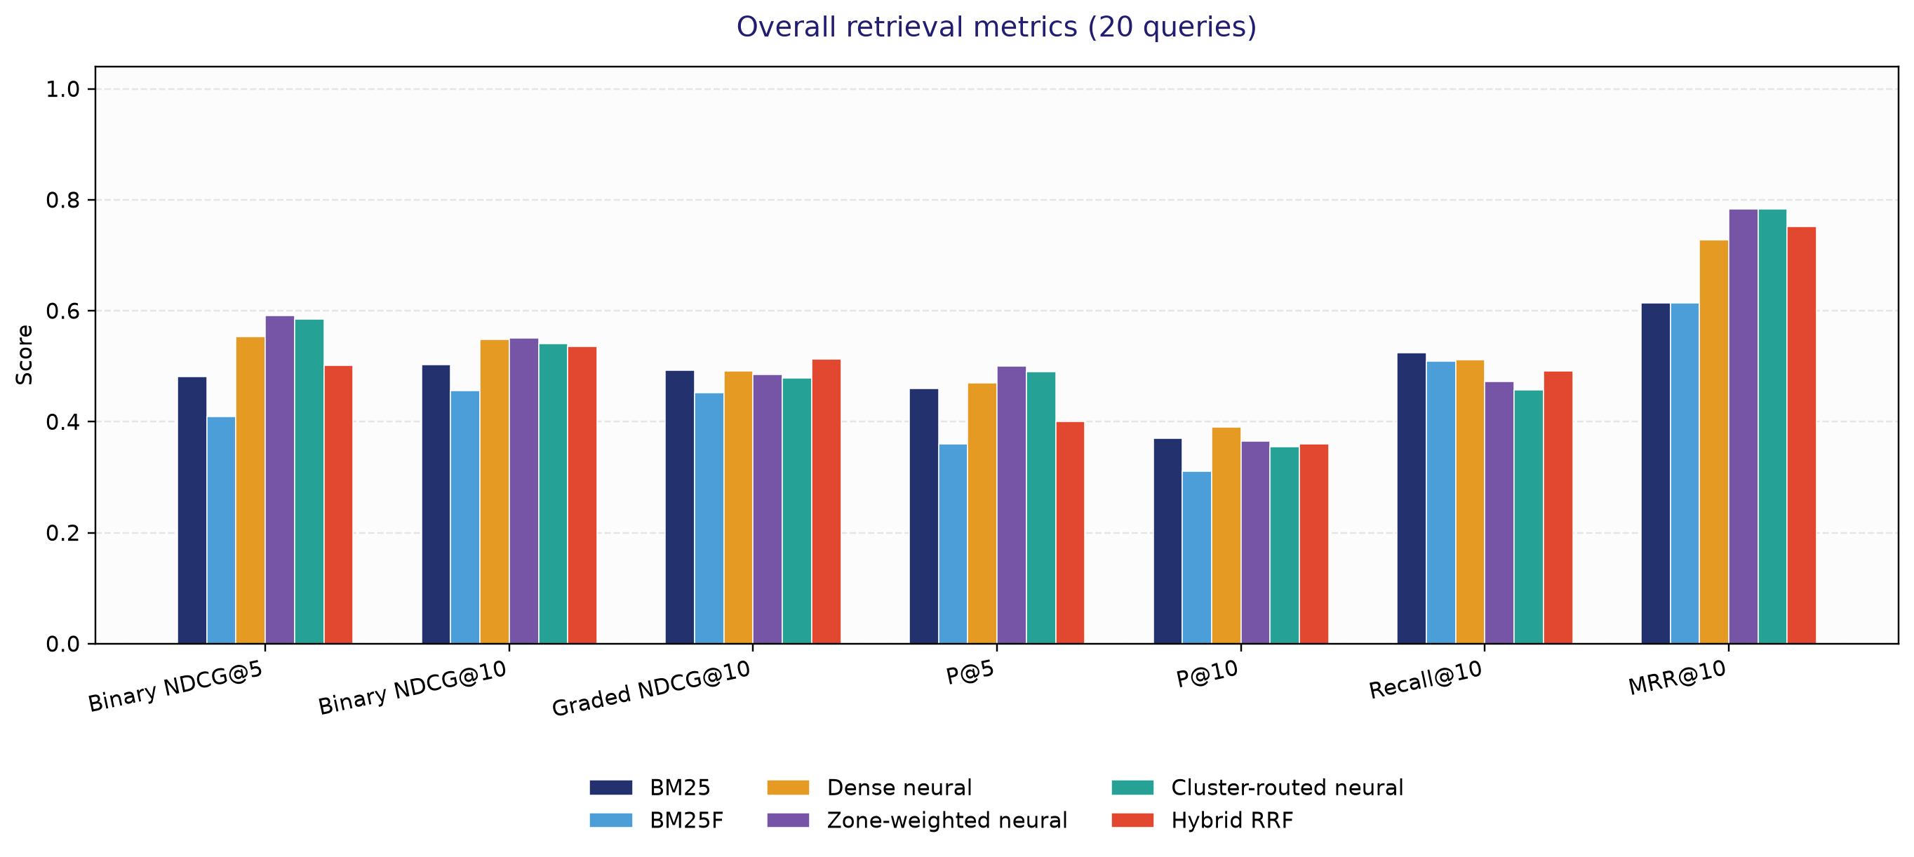
Benchmark results: Overall Combined (20 Queries)
Comprehensive evaluation across all 20 technical queries (pooled judgment pool).
Method / Paradigm | Binary NDCG@5 | Binary NDCG@10 | Graded NDCG@10 | P@5 | P@10 | Recall@10 | MRR@10
Flat BM25 | 0.481 | 0.502 | 0.493 | 0.460 | 0.370 | 0.525 | 0.614
BM25F | 0.410 | 0.456 | 0.452 | 0.360 | 0.310 | 0.509 | 0.614
Dense Neural | 0.553 | 0.548 | 0.491 | 0.470 | 0.390 | 0.511 | 0.728
Zone-Weighted Dense | 0.591 | 0.551 | 0.485 | 0.500 | 0.365 | 0.472 | 0.783
Cluster-Routed Dense | 0.585 | 0.541 | 0.478 | 0.490 | 0.355 | 0.458 | 0.783
Hybrid RRF | 0.502 | 0.535 | 0.512 | 0.400 | 0.360 | 0.491 | 0.752

Slide 15
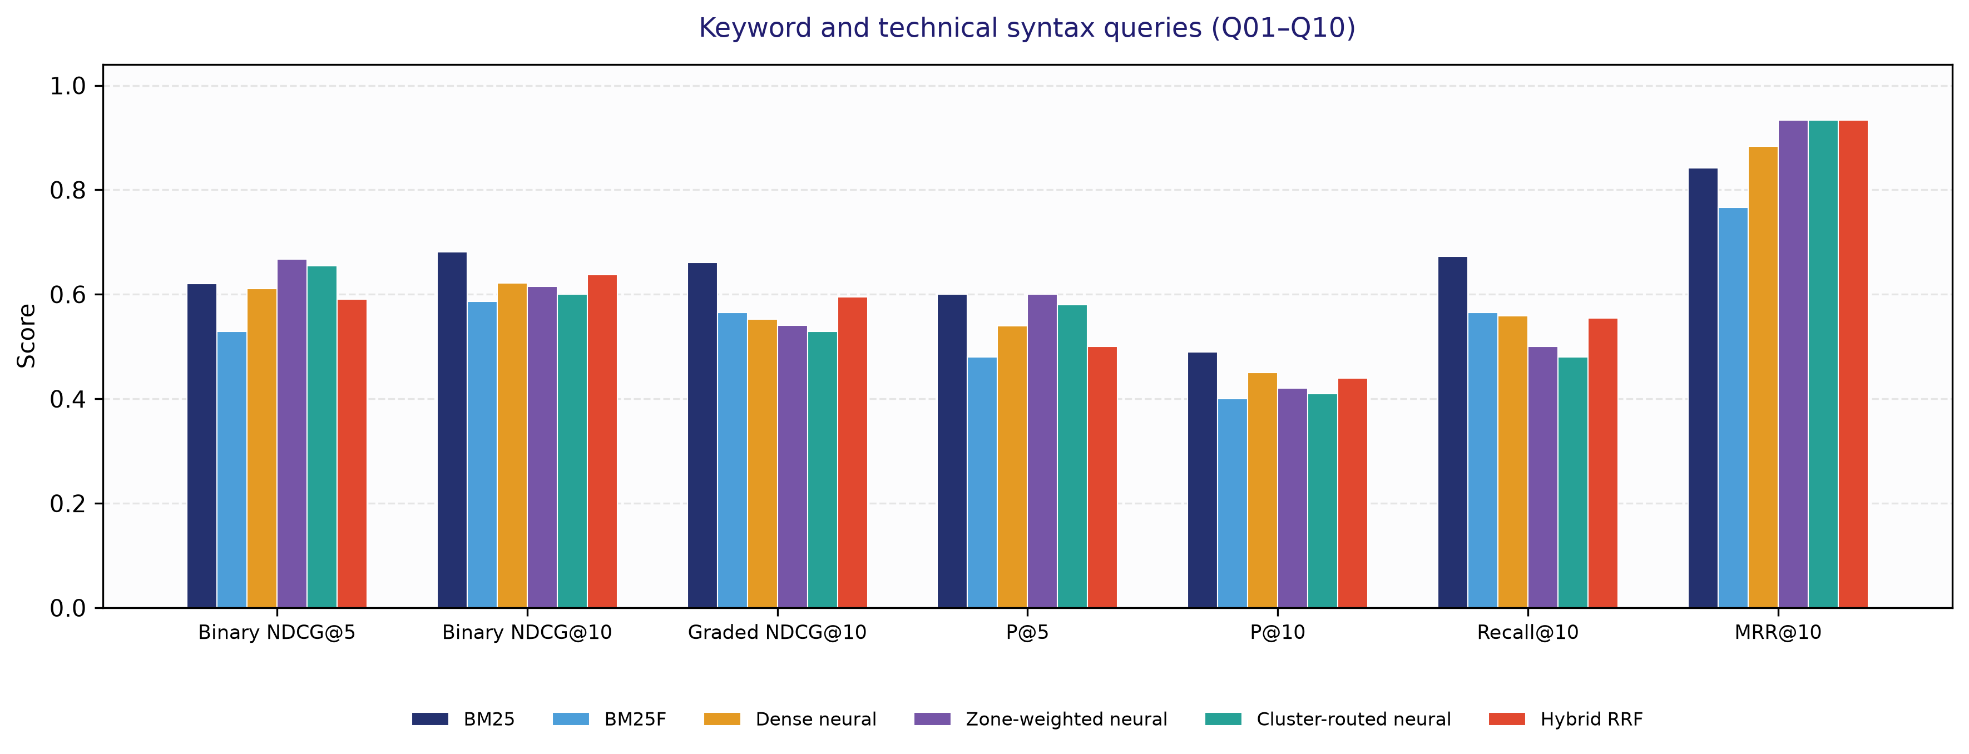
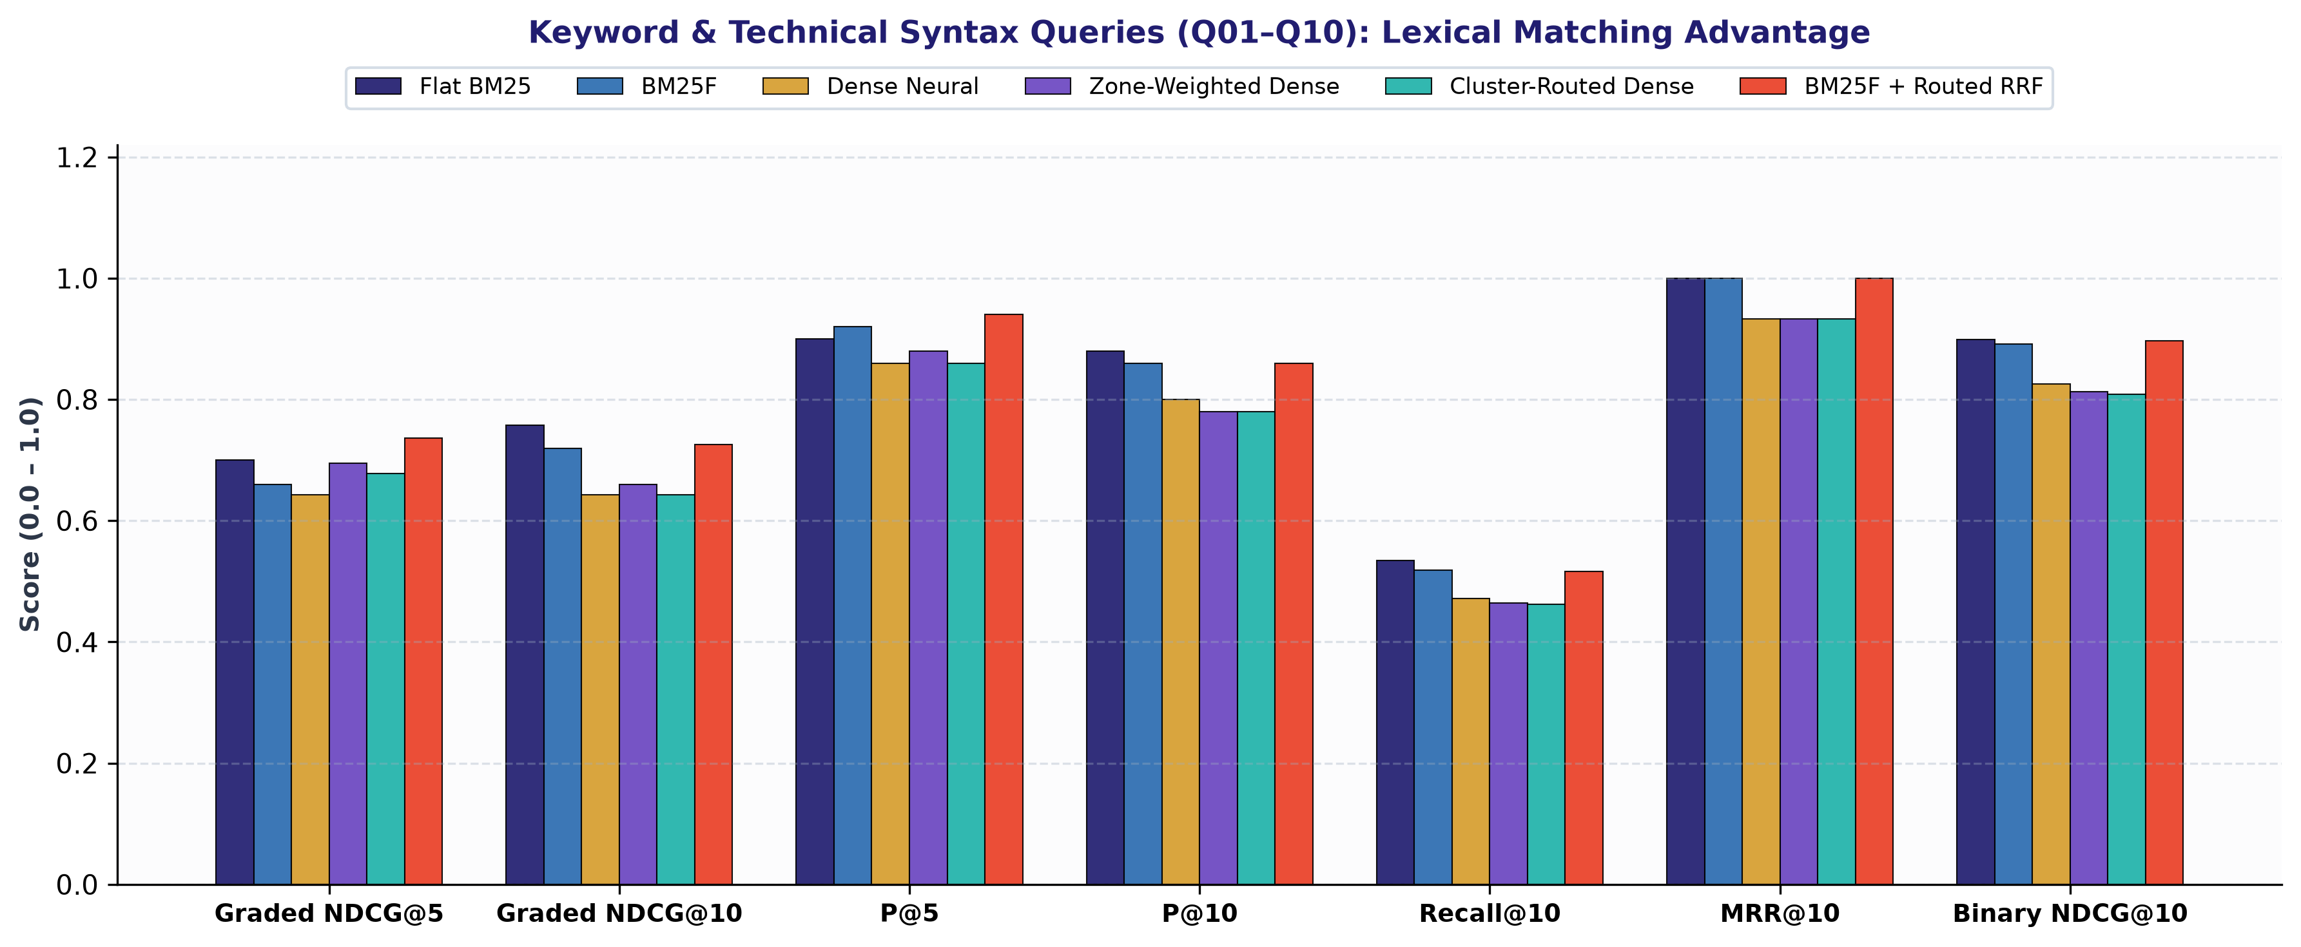
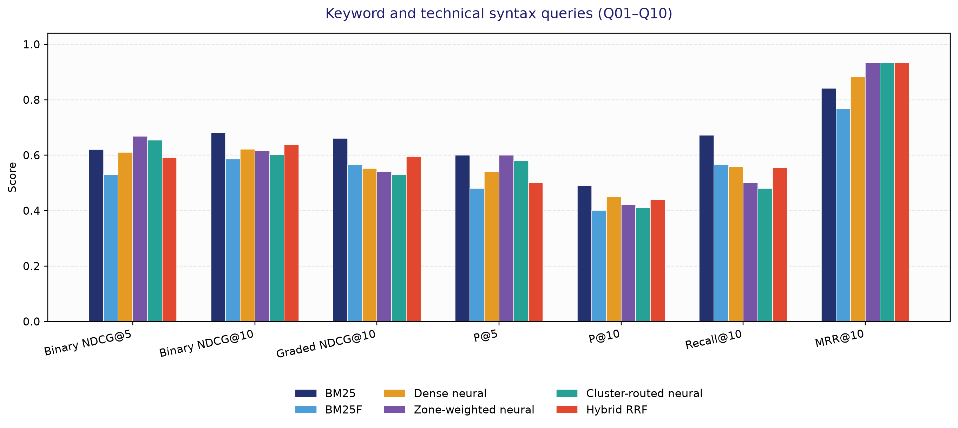
Benchmark results: Keyword & Technical Syntax (10 Queries)
Queries Q01–Q10 include technical identifiers, command syntax and keyword-focused questions.
Method / Paradigm | Binary NDCG@5 | Binary NDCG@10 | Graded NDCG@10 | P@5 | P@10 | Recall@10 | MRR@10
Flat BM25 | 0.621 | 0.681 | 0.661 | 0.600 | 0.490 | 0.672 | 0.842
BM25F | 0.529 | 0.586 | 0.565 | 0.480 | 0.400 | 0.565 | 0.767
Dense Neural | 0.611 | 0.622 | 0.552 | 0.540 | 0.450 | 0.558 | 0.883
Zone-Weighted Dense | 0.668 | 0.615 | 0.540 | 0.600 | 0.420 | 0.500 | 0.933
Cluster-Routed Dense | 0.655 | 0.601 | 0.530 | 0.580 | 0.410 | 0.480 | 0.933
Hybrid RRF | 0.591 | 0.638 | 0.595 | 0.500 | 0.440 | 0.555 | 0.933

Slide 16
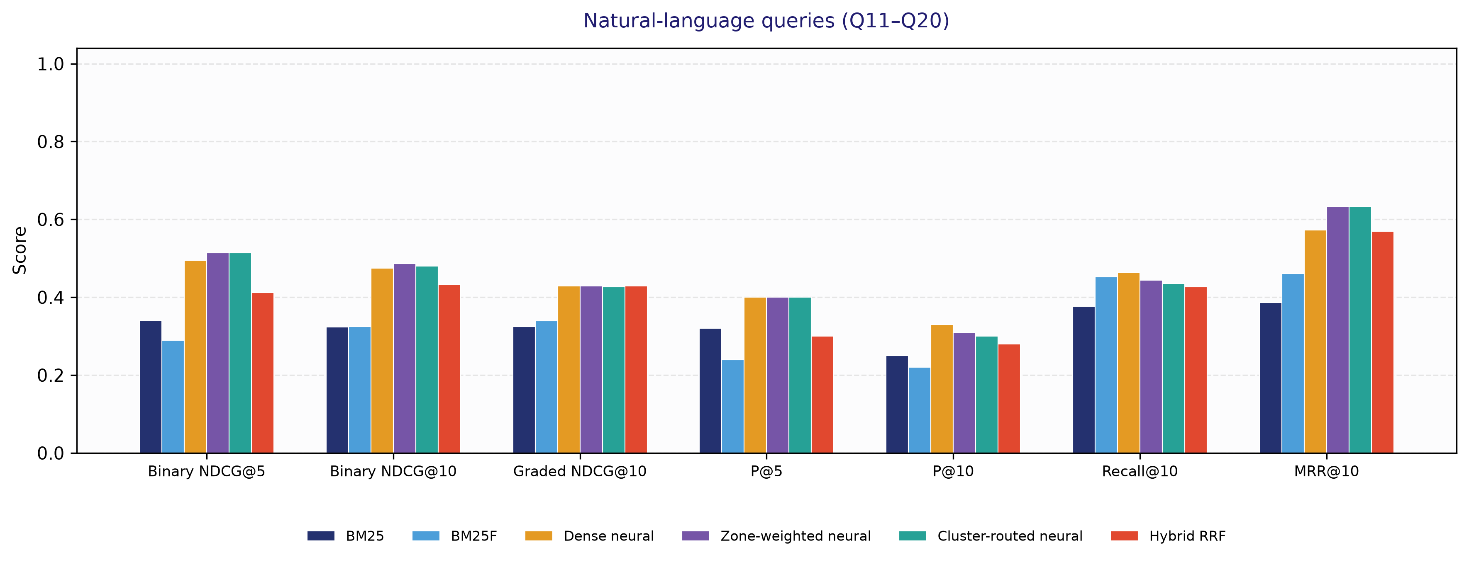
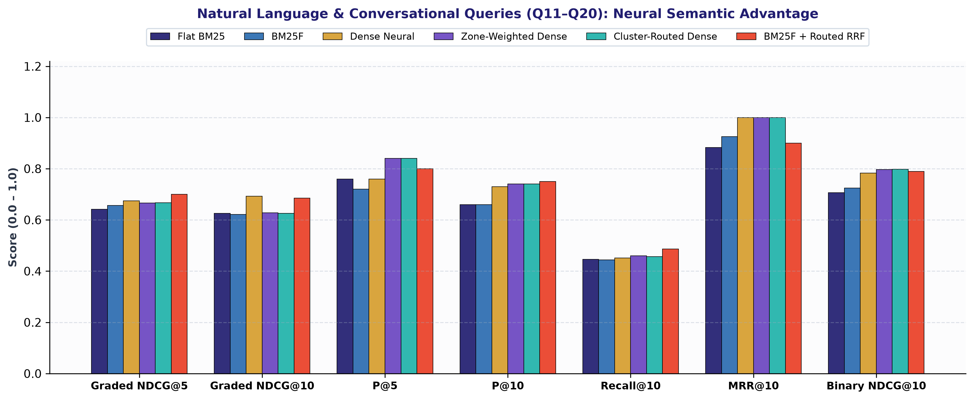
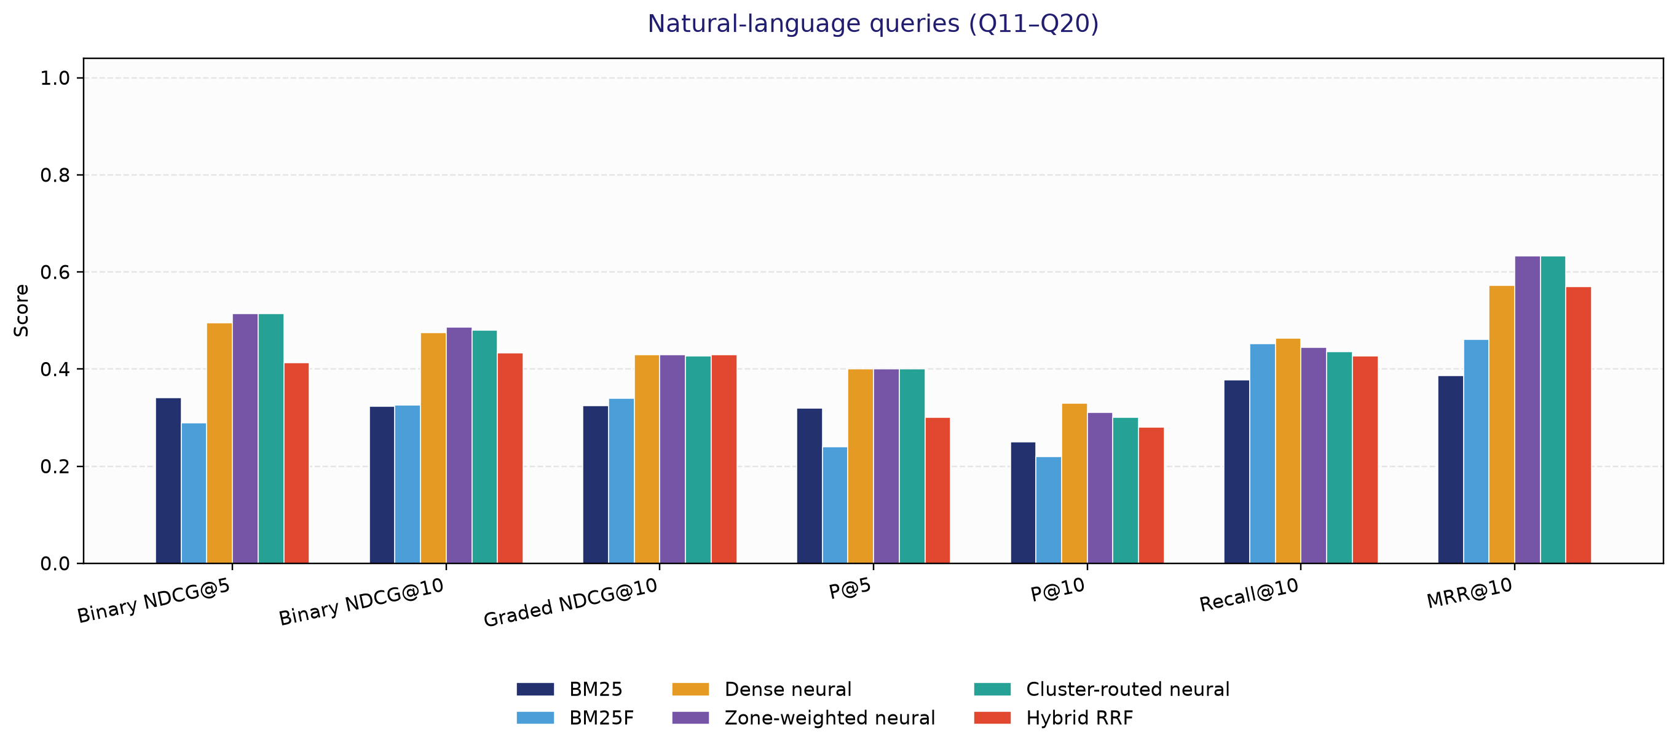
Benchmark results: Natural Language & Conversational (10 Queries)
Queries Q11–Q20 include symptom descriptions and conversational technical questions.
Method / Paradigm | Binary NDCG@5 | Binary NDCG@10 | Graded NDCG@10 | P@5 | P@10 | Recall@10 | MRR@10
Flat BM25 | 0.340 | 0.323 | 0.325 | 0.320 | 0.250 | 0.377 | 0.387
BM25F | 0.290 | 0.325 | 0.340 | 0.240 | 0.220 | 0.452 | 0.461
Dense Neural | 0.495 | 0.474 | 0.429 | 0.400 | 0.330 | 0.464 | 0.573
Zone-Weighted Dense | 0.515 | 0.486 | 0.429 | 0.400 | 0.310 | 0.444 | 0.633
Cluster-Routed Dense | 0.515 | 0.480 | 0.427 | 0.400 | 0.300 | 0.435 | 0.633
Hybrid RRF | 0.412 | 0.433 | 0.429 | 0.300 | 0.280 | 0.426 | 0.570

Slide 17
Query examples: exact syntax and conversational intent
Exact syntax · Q05 Docker Buildx
Conversational · Q11 Spring Boot
Query
“docker build --mount=type=cache syntax”
BM25 / BM25F
Binary NDCG@10: BM25 0.7365; BM25F 0.5500.
Dense neural
Binary NDCG@10: 0.4035; zone-weighted 0.4035; routed 0.4035.
Hybrid RRF
Binary NDCG@10: 0.5407. Graded NDCG@10: 0.5118.
Query
“quickest way to initialize a basic spring boot rest service without bloated boilerplate”
BM25 / BM25F
Binary NDCG@10: BM25 0.5373; BM25F 0.5337.
Dense neural
Binary NDCG@10: 0.6332; zone-weighted 0.5392; routed 0.4729.
Hybrid RRF
Binary NDCG@10: 0.4937. Graded NDCG@10: 0.4701.

Slide 18
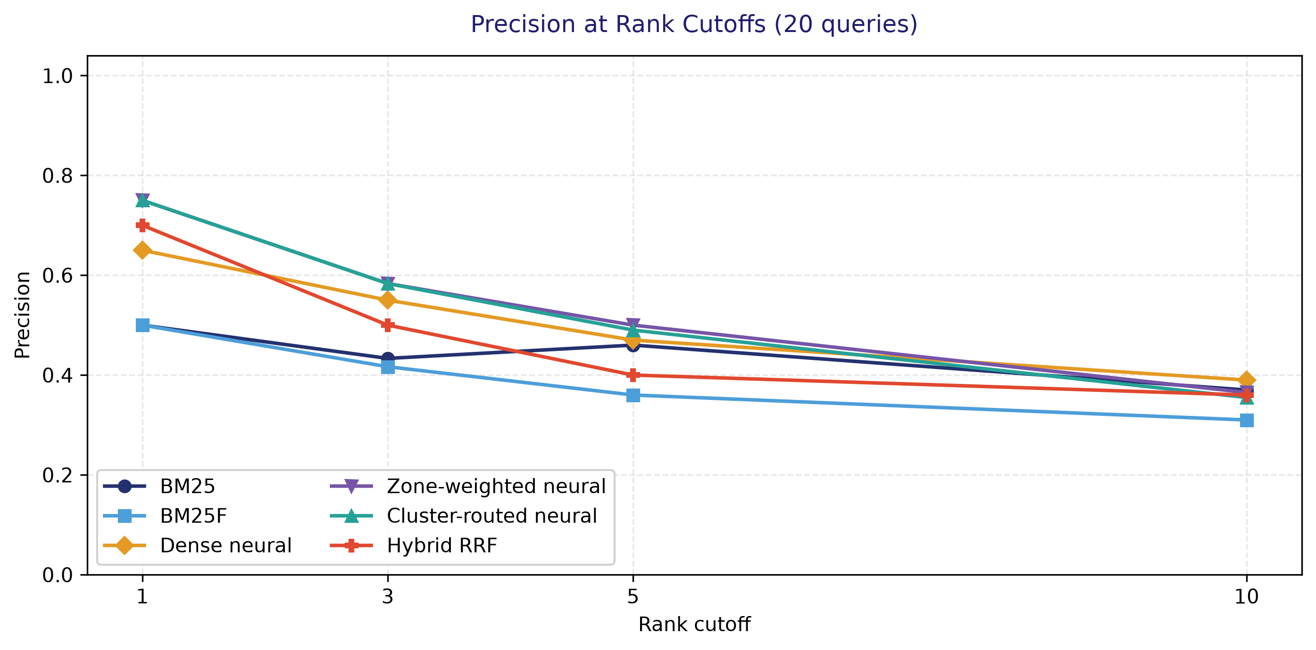
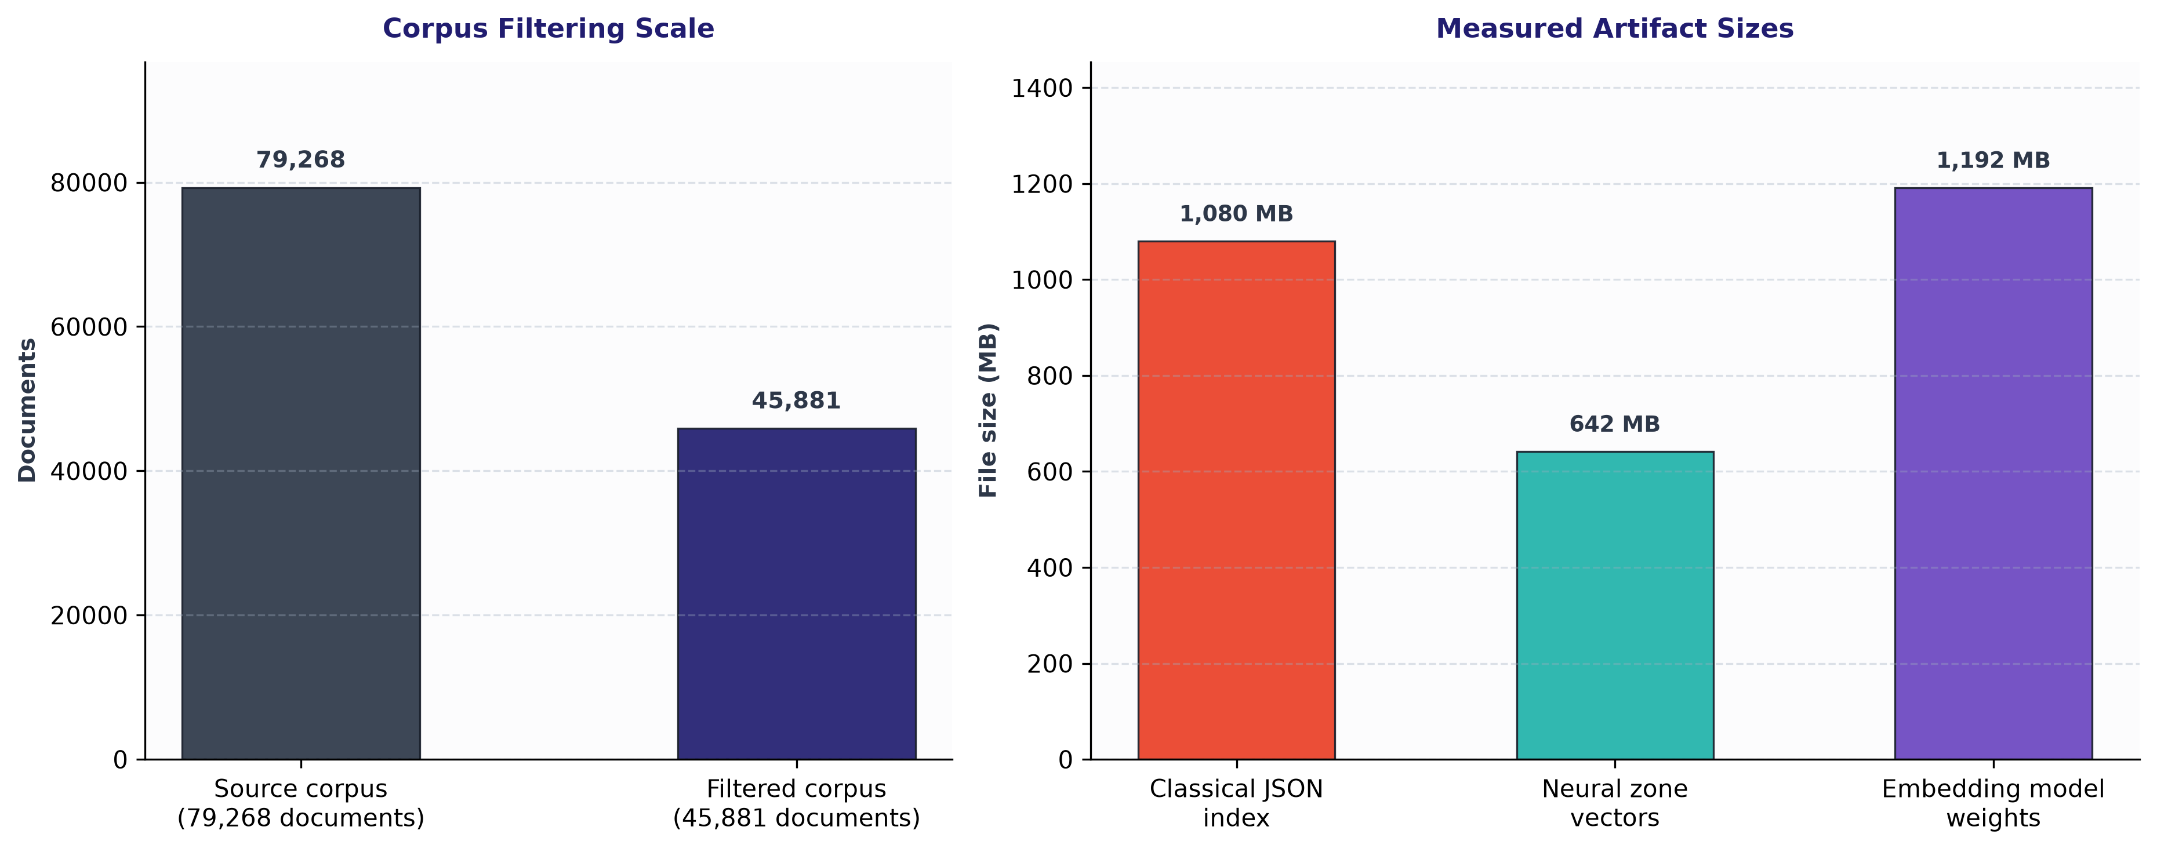
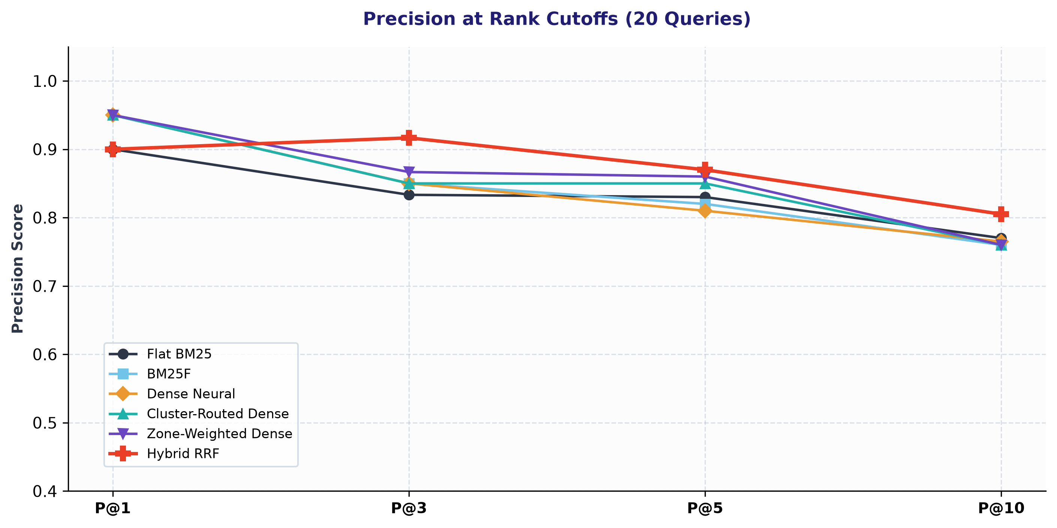
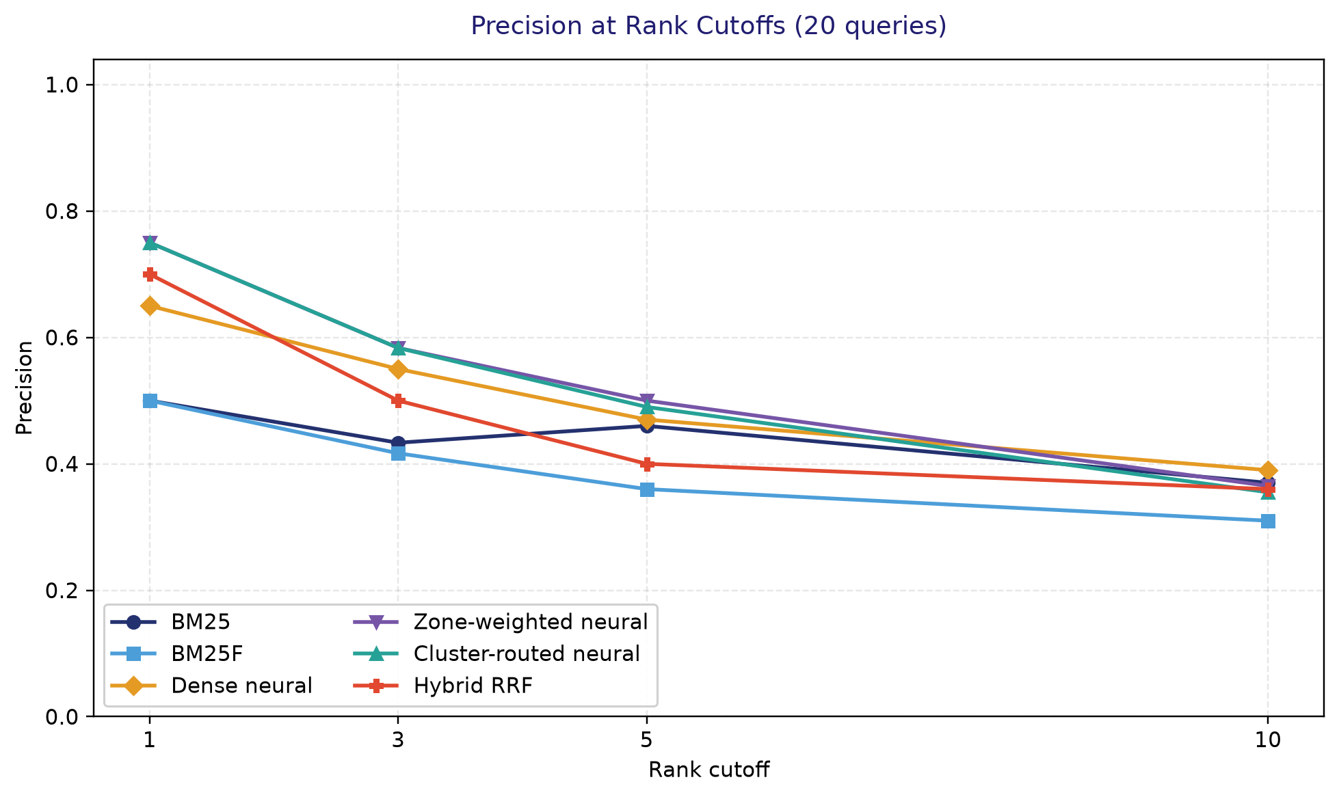
System trade-offs and takeaways
Takeaways
Corpus filtering
The filtered corpus contains 45,881 documents from 79,268 source documents.
Index footprint
The classical JSON index file is 1.08 GB. Runtime RAM was not measured.
Neural search
On Q11–Q20, dense Binary NDCG@10 is 0.474 versus 0.323 for BM25.
Cluster routing
Routing scans 61.1% fewer passage vectors; Binary NDCG@10 is 0.541 versus 0.548 for full dense search.
Zone weighting and RRF
Zone-weighted Dense has the highest overall Binary NDCG@10 (0.551); Hybrid RRF has the highest Graded NDCG@10 (0.512).
Caching
The system caches ranked results and query embeddings using configured LRU caches.

